Slide 1

Module Two: The Role of Information Assurance and Security
CIS 303 – Prof. C. R. Johnson

Slide 2
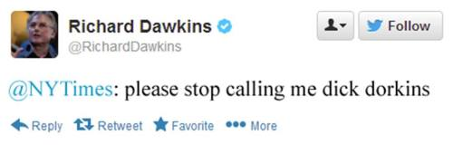
Contextualizing Online Society
The word meme was coined in 1976 by the evolutionary biologist Richard Dawkins. It is a word to describe the concept of “cultural transmission.” The proliferation of customs and ideas, not via broadcast, but person to person.
Zeitgeist – The defining spirit or mood of a period in history as shown by the ideas and beliefs of the time.
Roaring 20s.
Hegemony – The predominance of once social group over others.

Slide 3
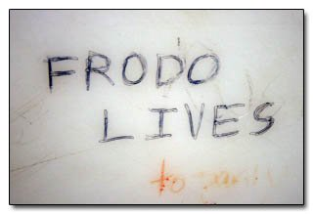
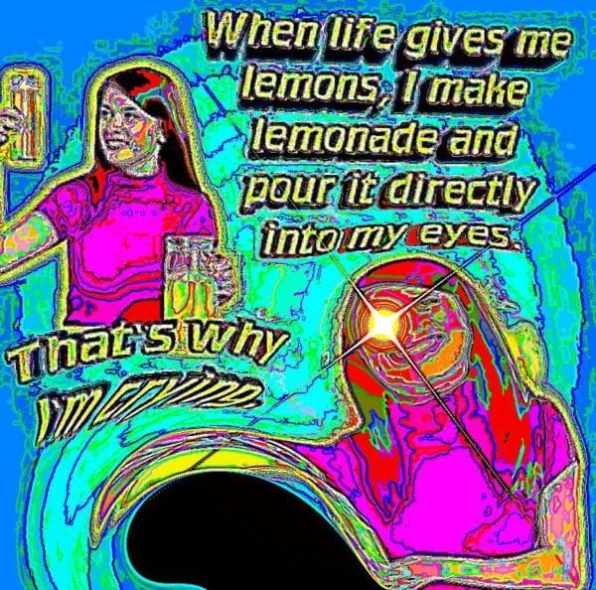

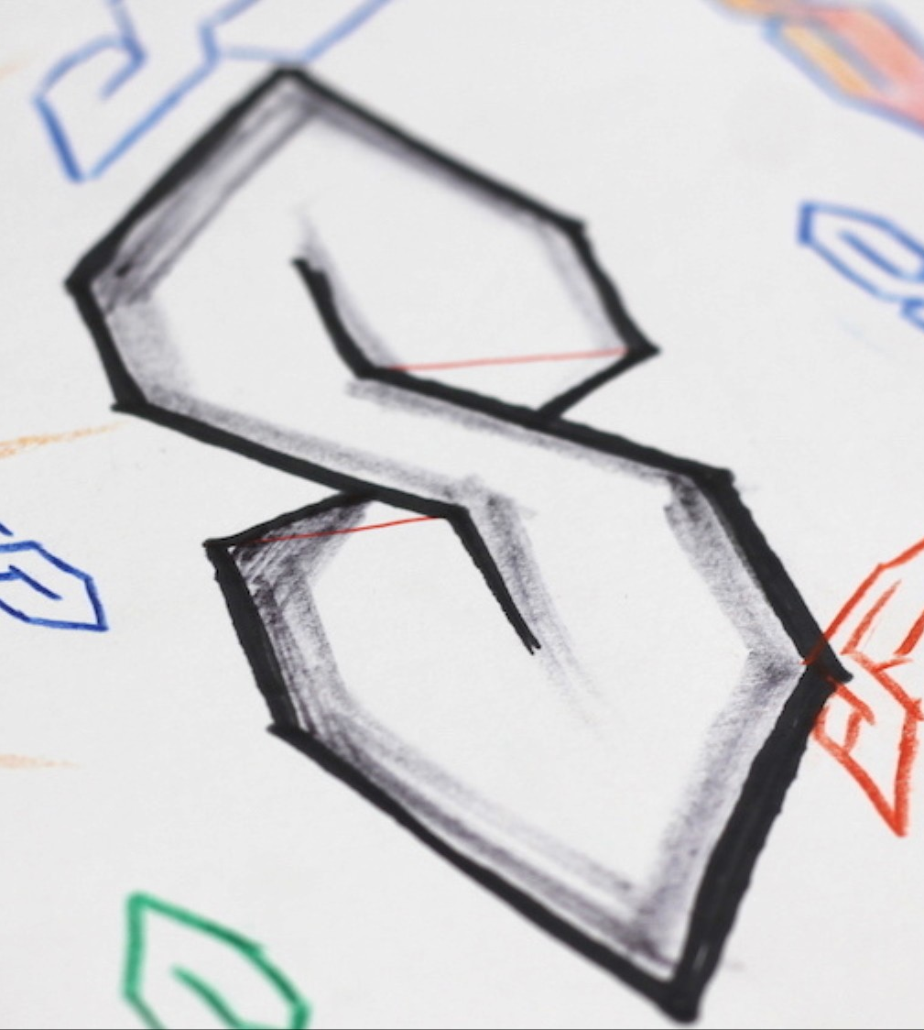
Okay?

Slide 4
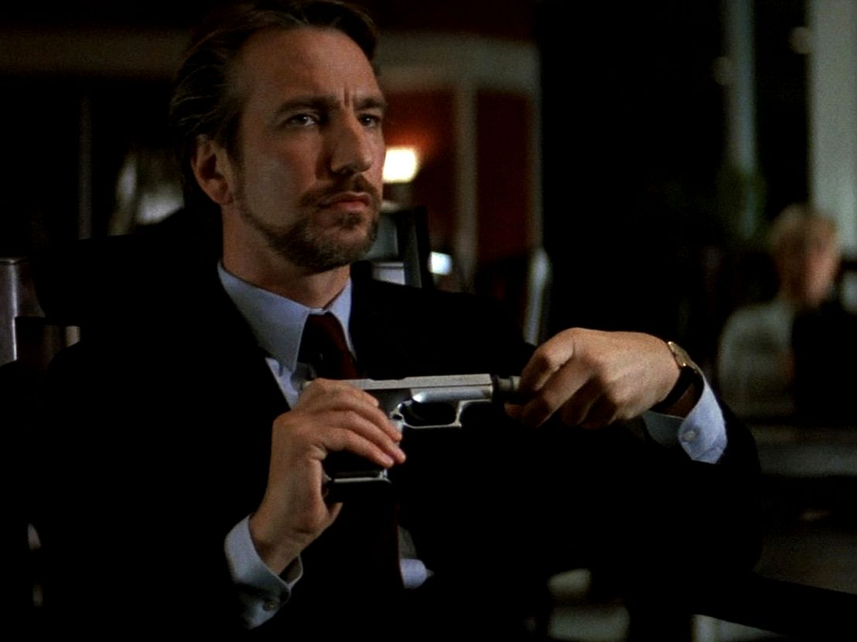

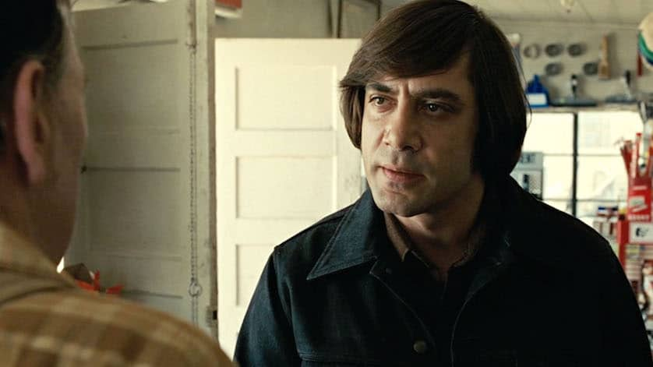


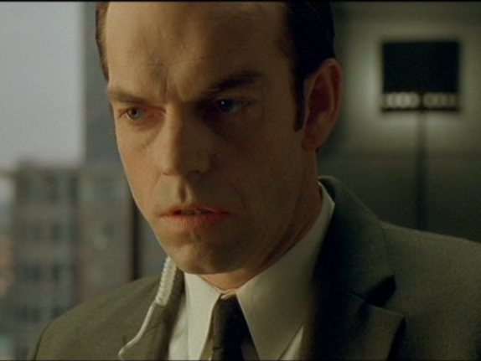

Slide 5
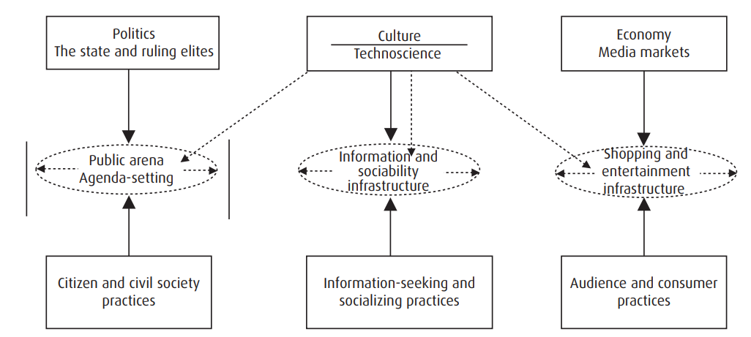
Online IRL

Slide 6
The only secure computer…
“The only truly secure system is one that is powered off, cast in a block of concrete and sealed in a lead-lined room with armed guards - and even then I have my doubts.”
"Computer Recreations: Of Worms, Viruses and Core War" by A. K. Dewdney in Scientific American, March 1989, pp 110.
Notes:
Information Security
vs.
Information Assurance

Slide 7
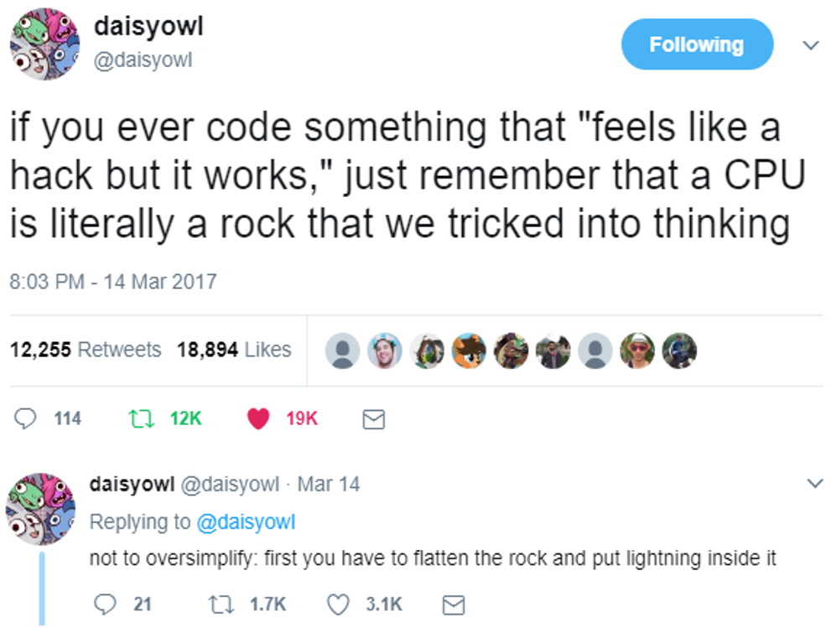

Slide 8
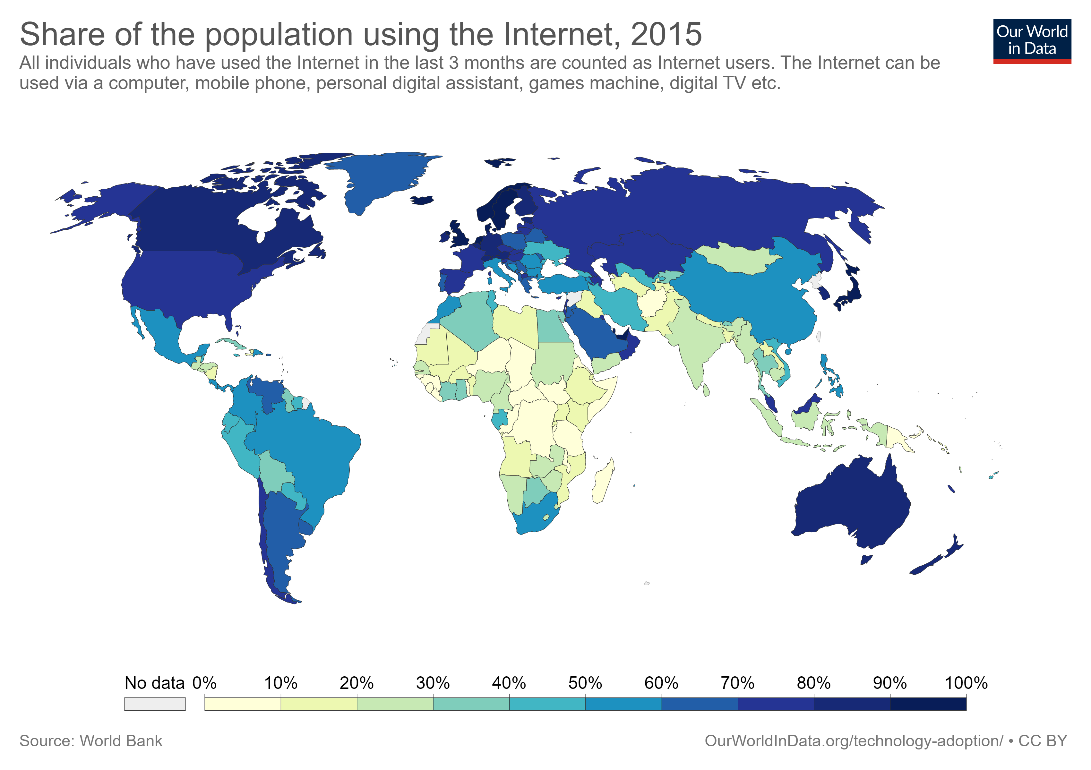
Digital Sociology
Social issues with the Internet.
Inequality
Change of public and social capital
Venue change of deliberative democracy
Court of public opinion
Identity, culture
Social/mood disorders both as a result and its impact on the above.
Social order / dehumanization

Slide 9
Info Sec Ethics
A business has an obligation to customers, employees, and shareholders (in whatever order.) Employees have an obligation to the business. Info Sec employees have an obligation to the public and the profession.
A failure to abide by ethical standards is not just a mistake – it is a professional failure.
Notes:
Data security professionals that do not follow professional principles
Privacy / Compliance professionals that do not follow standards
Violation of laws, contracts, and trust.
Security knows the blind spots, gaps – or should.

Slide 10
(ISC)² Code of Ethics
1) Protect society, the common good, necessary public trust and confidence, and the infrastructure
2) Act honorably, honestly, and legally
3) Provide diligent and competent service to principals
4) Advance and protect the profession

Slide 11
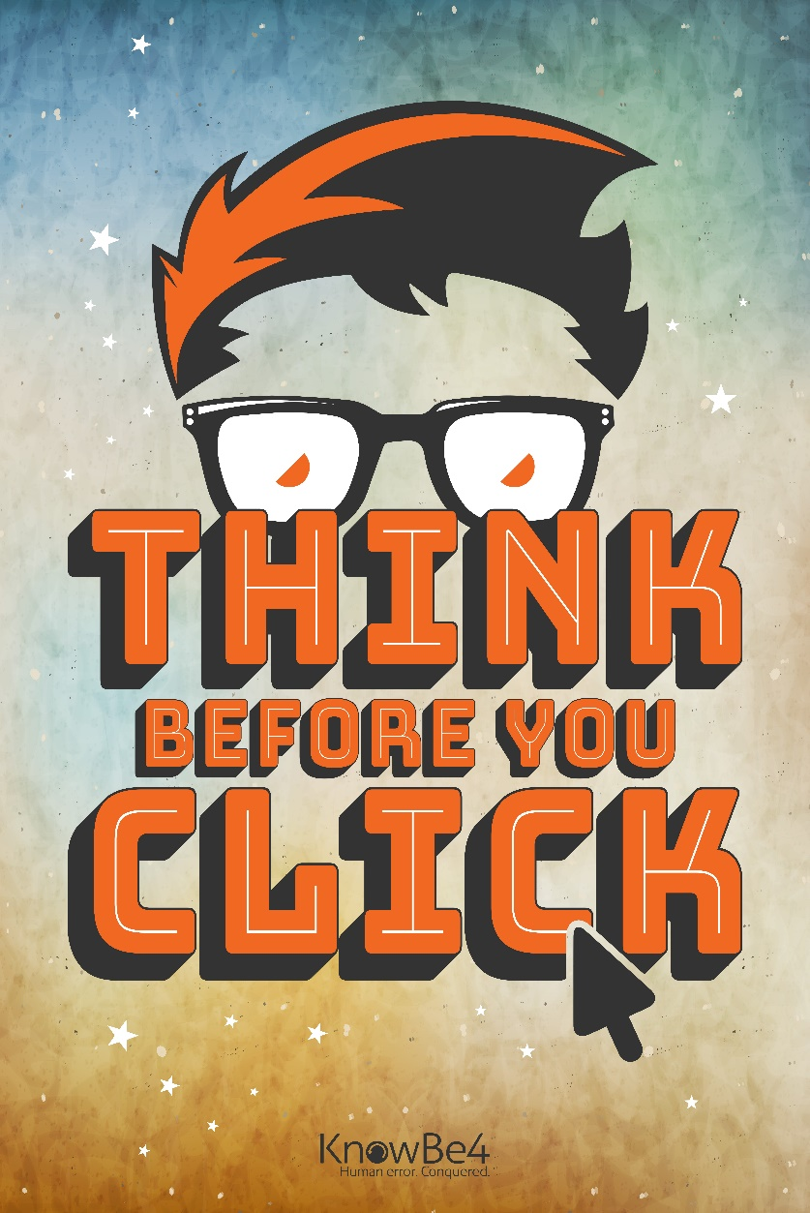
A lot of cyber, not enough social
Security is always ultimately a human problem.
Cybersecurity as a discipline tends to see people as components in a security system.
A cannot patch, but we can teach.
We acknowledge the weakness, but not the problem.
Notes:
We sardonically fill in the blanks follow incidents, answering the question “WHY did they respond to the phish and give away their password” with the least charitable terms.

Slide 12
New Frontiers, Same Order
Four elements distinguish online interactions from offline interactions.
Anonymity (Pseudonymity)
Permanence
Constant connectivity
Depersonalization/Deindividuation

Slide 13
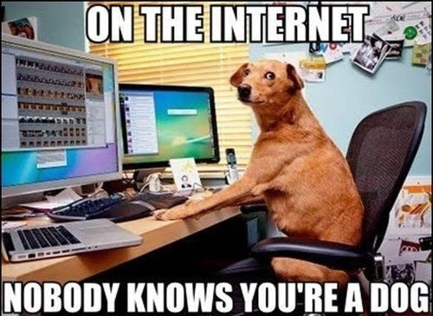
Distinguishing features of online
While anonymity provides a place where all are equal and idea should stand on their own merits, that didn’t exactly happen, did it? – Why?
Notes:
Many choose to define ourselves by existing personas/identities.
This brings old, irrelevant baggage into a place where it truly does not matter and is never involuntarily offered.
At times, voluntarily offering this information is seen as gauche or manipulative.
Other times these old divisions are seen as a way to provide social leverage in a place where it is effectively meaningless.

Slide 14
Persona ex Machina
Are you outgoing, or shy? Patient, or impatient? Empathetic, or callous?
Each trait is part of what is known as a behavioral schema, which is a mental structure internal to us that helps us to organize what we think and guide what we do.
Notes:
Each of us has several schemas. We have a friend schema, a child schema, an employee schema, a buyer schema, a driver schema, and so on.
It is entirely possible for our schemas to have contradictory traits.

Slide 15
Persona ex Machina
You are not the same person with friends as you are with your parents.
Code-switching
Behavioral Schema
We adopt many personas in many situations. Online, we may adopt many personas for similar situations.
To find out what a person is truly like, remove all consequences from their actions.
Identity -> Behavior -> Persona

Slide 16
Persona ex Machina
Multiple schemas are a perfectly normal social adaptation. They give us context to deal with new situations effectively and prepare us for times when we experience a sudden change in life.
If we have no schema for a situation, we simply don’t know how to act or think when, for example, meeting someone new. If we suddenly experience the loss of a significant other and have no other schema, we are left unsure how to even go on with life.
For this reason, many people experiencing such loss will suddenly pour themselves into their work or hobbies, as those are their next most significant schema. Our behavior in these schemas is known as a persona.

Slide 17
Persona ex Machina
In our lives, our personas are most often based upon how we identify. Our own perceived gender, profession, ethnicity, age, etc. These are traditional personas and formulate context for interpersonal relationships where they come into play. However, much of our communications today do not rely upon those factors.
Traditional personas are defined by what we are. None of this information is involuntarily offered over the Internet.
In virtual environments, the only significant persona is known as the behavioral persona, which is defined by what we do. In the Internet, this is sometimes referred to as an individual’s digital identity, or merely identity for the sake of brevity.

Slide 18
Social Norms
Normative Code. These unwritten rules tell us what is acceptable and what is not.
Sometimes, we have written rules that tell us what is acceptable or not. These rules are the Legal Code.
The laws say certain drugs are illegal and some are not. The norms tell us that there is an acceptable and unacceptable way to use legal drugs.
You drink alcohol at parties, weddings, etc. is ok. It is deviant to drink at work, in the morning, etc.
Drink coffee in the morning and/or at meals. It is deviant to drink coffee at 11pm (unless you have an excuse.)
Enjoying anime is acceptable. It is deviant to purchase a waifu pillow.
Playing videos games is fine. It is deviant to play games at the exclusion of all other activities.

Slide 19
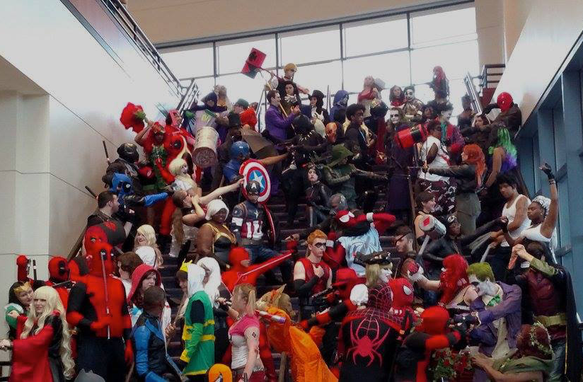
Social Norms
What happens when people get together and partake in a shared experience? Bonding. The shared experience of any deviant activity is the same, combined with the shared experience defying social contexts, is a powerful reinforcement mechanism.
When an activity is frowned upon the subculture is strengthened. This is doubly true when the activity is illegal as well as deviant, as these out-groups become more insular and more dependent upon each other.

Slide 20
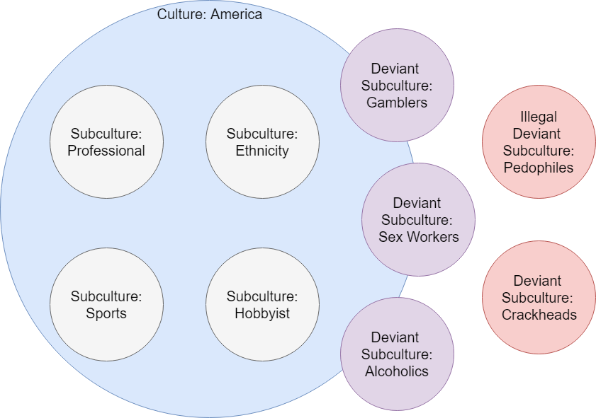
Notes:
Albert Cohen (1955) explained the formation of subcultures thus:
“The crucial condition for the emergence of new cultural forms is the existence, in effective interaction with one another, of a number of actors with similar problems of adjustment.”
Or, in essence, that human behavior is conditioned to problem solving and that, when individuals face a similar problem, it is natural to come together to find group solutions to the, or to support the maladaptation to solutions provided by society.
All a subculture is: Normative and ideological features of a group derived from frequent interaction. Any group that has shared experiences will have a subculture. For example, truckers.
“Breaker, breaker 1-9 we got a Smokey on the double nickels east of Beer Town that just snagged a suicide jockey. Bear bait check your 20. I’m 10-10 on the side at the choke and puke until the bear hibernates. Over.”
Deviant subcultures, however, derive from frequent interaction of deviant behavior. You will see this in all such groups – pedophiles, prostitutes. Keep in mind that deviant behavior does not mean illegal behavior, because you will see this in legal-yet-deviant groups such as gamblers, nudists, and drug users (whether the drug is legal or not.)
The more marginalized a group, the stronger the identification/bond.

Slide 21
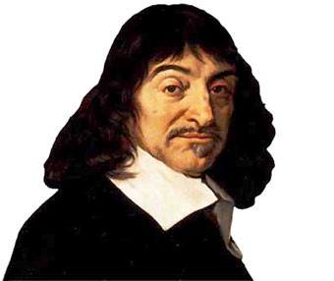
“Je pense, je suis.”
Solipsism – Cogito ergo sum.
Solipsism syndrome – Prolonged isolation leads to a disconnect from a sense of “real.” Reality does not exist outside of their own mind.
Loneliness
Detachment
Indifference/Apathy
Derealization
Dissociative episodes

Slide 22

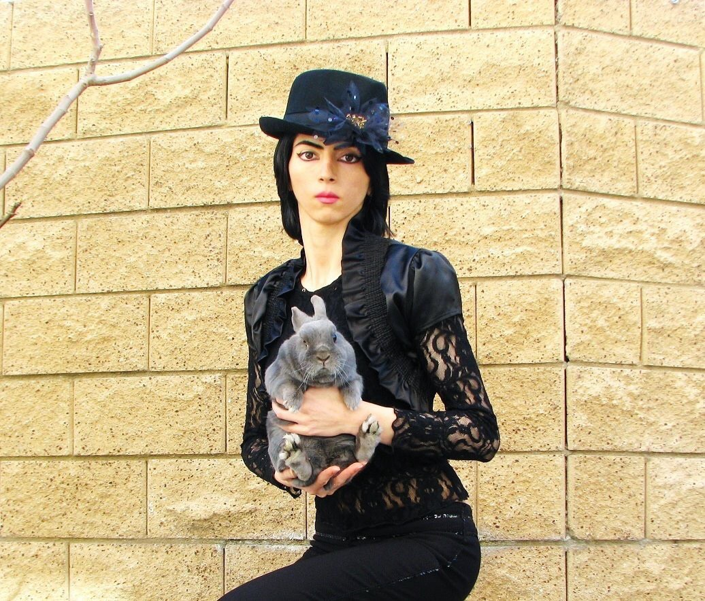



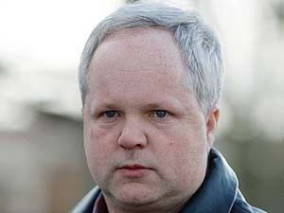
The Land of Ego
Solipsism Syndrome / Narcissistic Solipsism:
Social awkwardness
Social maladaptation
Inappropriate interpersonal interactions
Lack of sense of boundaries
In a more severe case – When nothing but you is real. Nothing but you matters. The suffering of others is an abstract concept. You get…

Slide 23
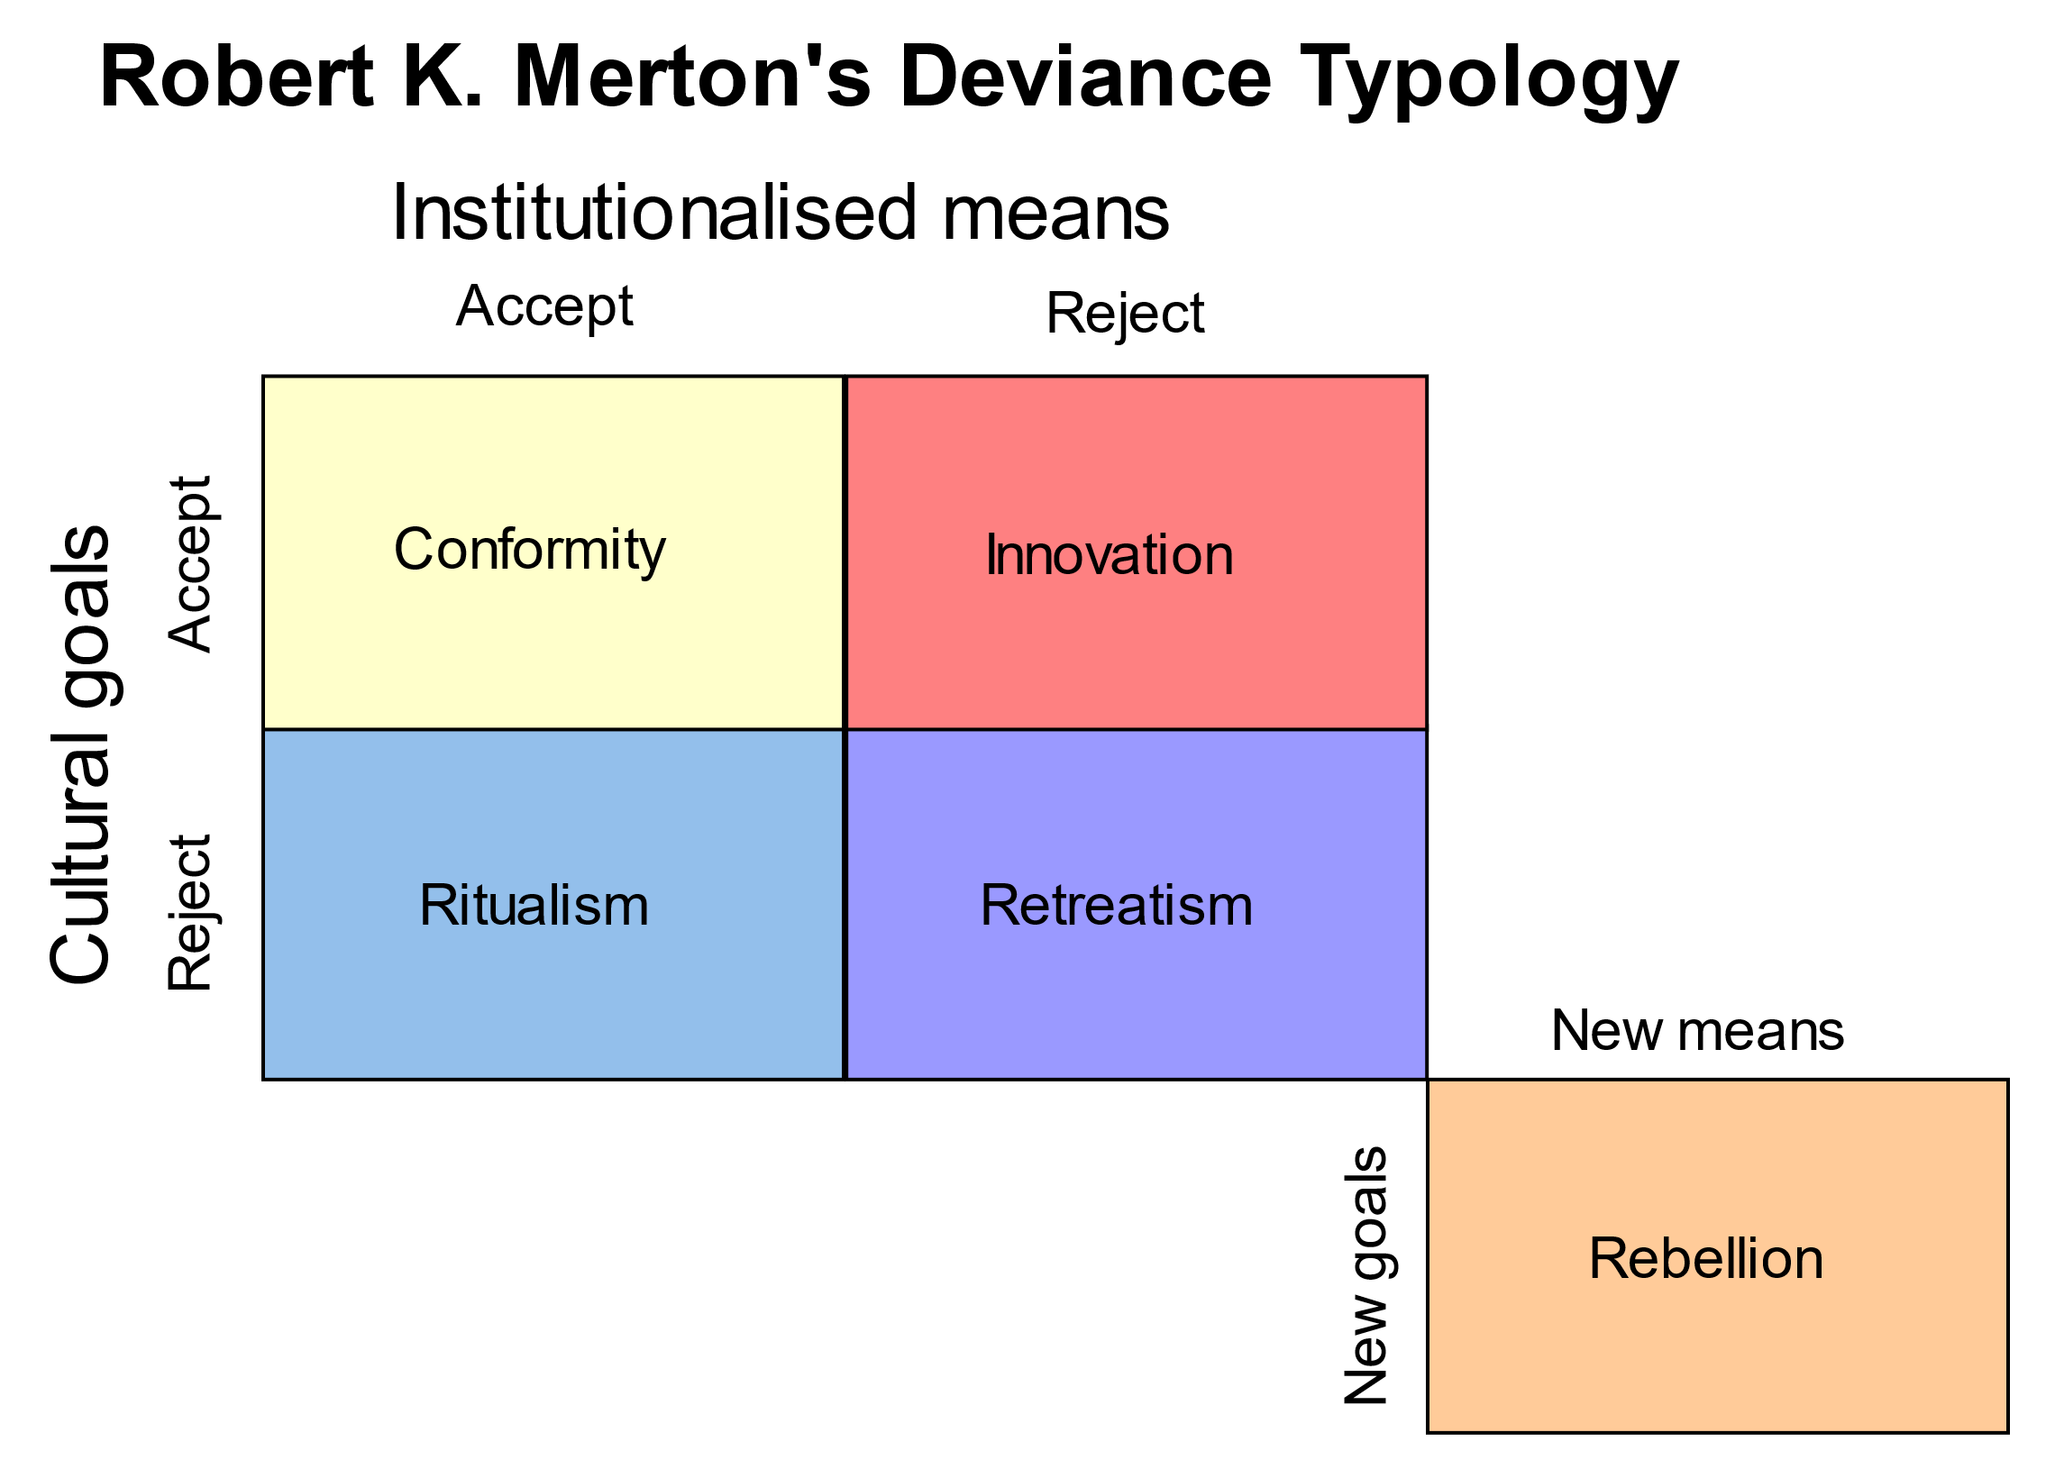
Whomst’ve Ever Deviates?
What makes someone gravitate toward deviances?
What makes someone cross the line from deviance to criminal deviance?

Slide 24
General Strain Theory
A theory that describes that human behavior is motivated by “strains” which we respond to – negative or positive.
Described that there are four strains that likely lead to criminal behavior:
1) Strains seen as unjust.
2) Strains are high in magnitude.
3) Strains associated with low social control.
4) Strains that create pressure or incentive to engage in criminal coping.
Notes:
Built off of a theory by Robert Merton, developed by Robert Agnew.
Strains seen as unjust. Like being written up for something they don’t see as their fault.
Strains are high in magnitude. Like major events like death or divorce.
Strains associated with low social control. Like being passed up for a promotion by someone with less experience.
Strains that create pressure or incentive to engage in criminal coping. Like getting into heavy debt or fall inw ith bad influences.

Slide 25

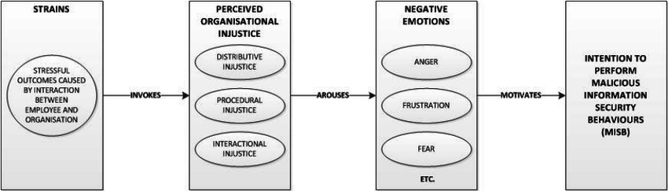
Notes:
Those suffering from this may seek “criminal coping”
Seeking quick profit to “keep up” with the appearance of wealth. For example, theft.
Getting revenge on those they see as the causes of strain. For example, harassment/assault.
Taking their frustration out on others as a way of alleviating these bad feelings. For example, cyber-bullying.
Explains computer crimes that are motives of profit, retributions, or personal in nature…

Slide 26
Types of Strain
Goal Blockage & Disjunction of Expectations
The inability to achieve a goal. A disjunction between aspirations and justice.
An inside actor that may feel disgruntled due to feeling they’ve reached a dead-end in their career or have faced denial for advancement, or reality has not lived up to expectations.
2018 Tesla leak – Disgruntled employee leaks sensitive and proprietary information after being passed up for a promotion.

Slide 27
Types of Strain
Presentation of noxious stimuli or loss of positive stimuli
An unpleasant, unexpected, or unwanted change in their environment.
An insider actor may feel disgruntled due to a perceived “loss of value” in their position.
2014 Morrison leak – Disgruntled employee leaks employee database following disciplinary hearing.

Slide 28
Lessons of General Strain Theory
Be mindful of how organizational changes impact individuals – even those not directly affected. Strain is a function of perception.
The focus is often in making decisions in ways that limit avoid potential confrontation or limit contact – that may not be the best way.
Understand that internal security risks that develop as a result of strain may not be directly observable in your environment (see next theory.)
Notes:
See:

Slide 29
Space Transition Theory
Persons with repressed criminal behavior have a propensity to commit crime in cyberspace which they would not otherwise commit.
Dark Tetrad traits, suppressed in real life, can manifest themselves when the offender is insulated from the social consequences of their actions.

Slide 30
Space Transition Theory
Dark Tetrad
Psychopathy
Sadism
Narcissism
Machiavellianism

Slide 31
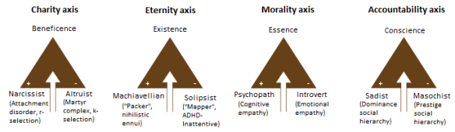

Slide 32
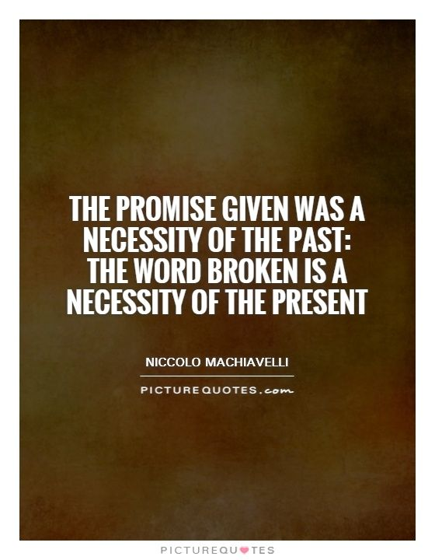

The Dark Tetrad
Machiavellianism
Those who would hurt others for personal gain.
Named after the philosophy espoused by Niccolò Machiavelli in The Prince.
People who score high on this trait are cynical (in an amoral self-interest sense, not in a doubtful or skeptical sense), unprincipled, believe in interpersonal manipulation as the key for life success, and behave accordingly.
Keeping secrets… or not…
Building up or tearing down other’s reputations based upon their usefulness
Calculated interactions (but not necessarily good at it) – playing people off each other in pursuit of a goal.

Slide 33
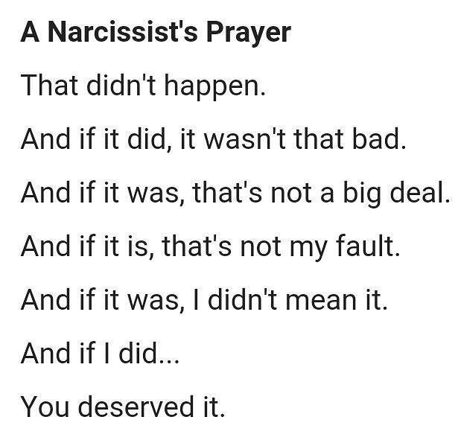
The Dark Tetrad
Narcissism
Those who would hurt others for attention / aggrandizement.
Individuals who score high on narcissism display grandiosity, entitlement, dominance, and superiority. Narcissism has also been found to have a significant correlation with psychopathy.
Have a sense of entitlement
Expect to be recognized as superior even without achievements that warrant it.
Believe they are superior
Be envious of others and believe others envy them
Belittle others to make themselves appear superior
Have secret feelings of insecurity, shame, vulnerability and humiliation

Slide 34
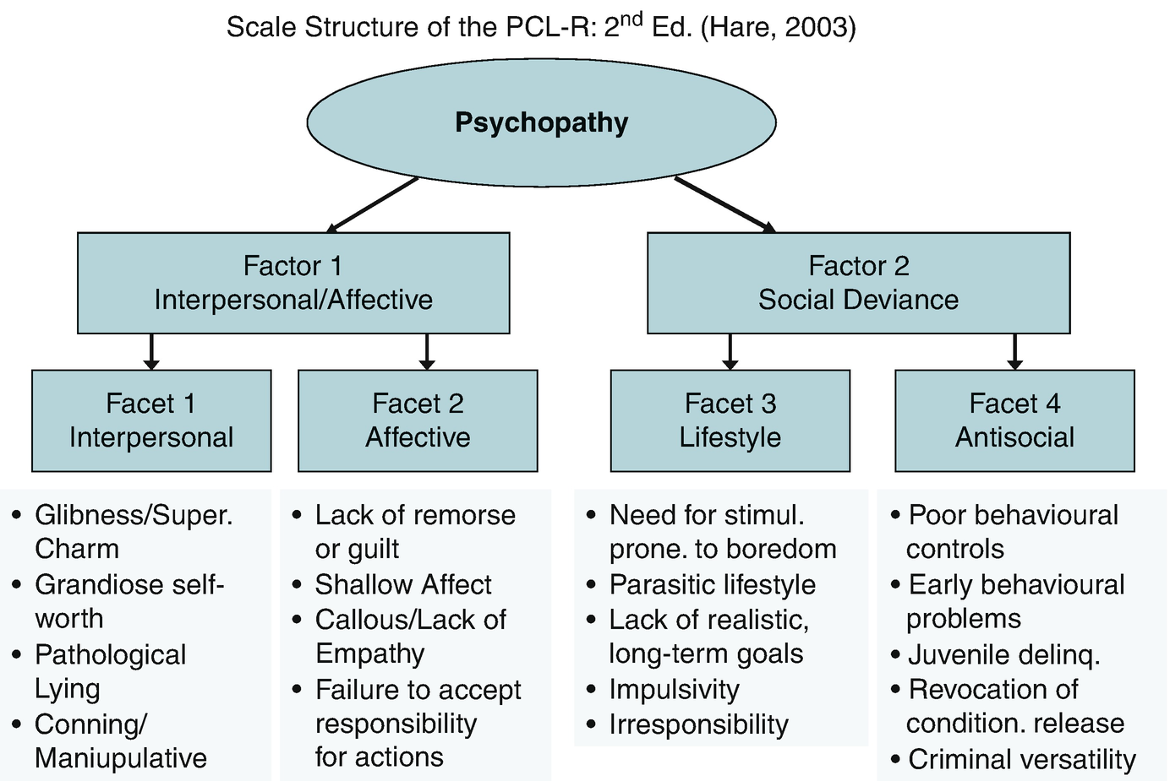
The Dark Tetrad
Psychopathy
Those who would hurt others because they do not care.
Considered the most malevolent of the dark triad, individuals who score high on psychopathy show low levels of empathy combined with high levels of impulsivity and thrill-seeking.

Slide 35
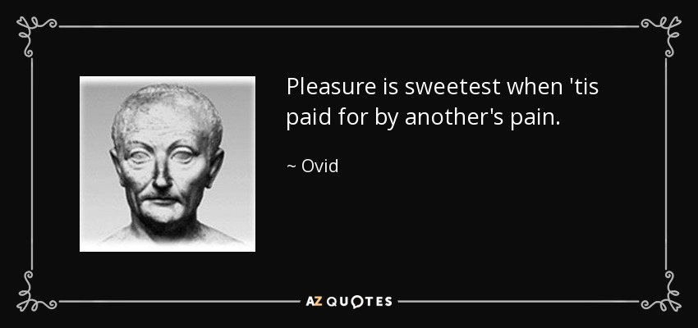
The Dark Tetrad
Sadism
Those who would hurt others for their personal enjoyment.
Exhibit cruel and aggressive behavior at times.
Preoccupation with violence.
Manipulation with fear.
Enjoy making people uncomfortable and watching them squirm.
Revenge-fantasy involving “punishment”
Dream up new ways to hurt people or “even the score.”

Slide 36
Casual Violence
Everyday/Casual Violence: Primarily experienced by women (but not exclusively). Essentially, the pervasive, constant fear that violence could be visited upon you at any moment.
Women seen as weaker/easier targets, but men are victims of violent crime more often.
Social norms – Women expected to be passive, “give people the benefit of the doubt” – men expected to sacrifice and protect
Fear of predation. Women experience assaults more often than men. Both from sources that should be “safe” – general lack of “safe” places in society today.
Increase of paranoia leads to maladaptive coping – see: Strain Theory.

Slide 37
Casual Apathy
Everyday/Casual Apathy: Primarily experienced by men (but not exclusively). Essentially, the pervasive, constant expression that you don’t matter or matter less than others.
The worst thing a woman can be is “cold” – the worst thing a man can be is “unproductive” or “unmanly.”
Social norms – suppressed emotion and trivializing mental health issues.
People seen as disposable/interchangeable.
Lack of acceptable outlets leads to maladaptive coping – see: Strain Theory.

Slide 38
Casual Sadism
Everyday/Casual Sadism: Experienced by both genders. Essentially the pervasive, constant fear that someone will target you for humiliation or arbitrary retribution.
Doxing, swatting
Cyberstalking, bullying
Deliberately marginalizing a coworker, classmate, or family member, or student

Slide 39
Space Transition Theory
Social norms are conditions of the social contract. Violation of that contract is reinforced by stigma. Criminal violations are punished by law.
Virtual environments do not make that reinforcement as direct.
Identity flexibility / relative anonymity
Lack of deterrence / oversight
Conflict of norms between deviance IRL vs online. See also: Solipsism Syndrome

Slide 40
Space Transition Theory
Four elements distinguish online interactions from offline interactions.
Anonymity (Pseudonymity)
Permanence
Constant connectivity
Depersonalization/Deindividuation

Slide 41
Lessons of Space Transition Theory
A person’s behavior offline may be different than their behavior online. A person’s nature is revealed in the absence of consequence.
In your environment, maintaining accountability is critical.
It does appear to be possible to perform behavior attribution via stylometry and behavioral analytics (See Kotikalapudi, et al. 2012, Carpenter, et al. 2016) – which may in the future be used to improve intrusion detection through identifying user intent.

